Slide 1



Data Preparation for Code Recommendation in IDE
Breaking down the problem
V.02 (16 Feb 2018)
Neelesh K Shukla
Department of Computer Science and Engineering, Indian Institute of Technology Guwahati, India
PVS Group, Institut fur Informatik, Universitat Heidelberg, Germany

Slide 2
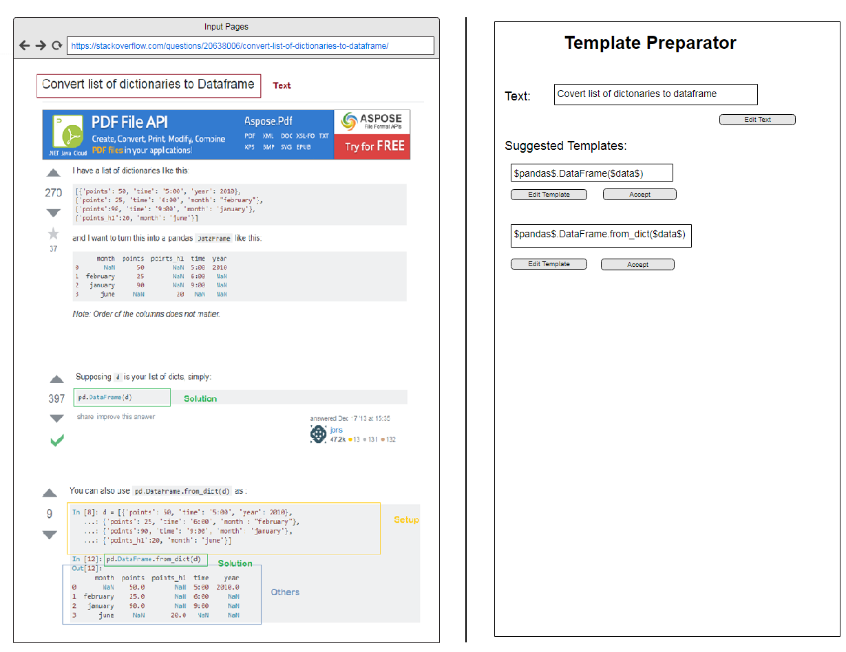


System Mock-up
A lists of available alternative sources for this „round“. A click on it re-loads the page on the left and reparses code (unless locked). Active source is highlighted (blue). Is this a good idea? Intention: allow to quickly compare what are best sources for a template, and with locks collect from multiple sources.
Template Editor
Sources
Web: Stackoverflow.com/questions/20638006/…
API: (pandas doc section)
Doc: (stackoverflow documentation record id)
Text: 1 2 3 ✗
Box for text, analogous as for code (see below).
Description
Convert list of dictionaries to dataframe
Lock/unlock switch: if locked, content does not change if user switches the sources or give hints. Otherwise content is updated.
Comment
Create a dataframe from a list of dictionaries $list_of_dictionairies$
Black frame: text boxes which are editable (and scrollable)
Doc link
Stackoverflow.com/questions/20638006/…
Code
$pandas$.DataFrame.from_dict($list_of_dictionairies$ )
Browse History, Find in DB, Add Parameter/ Group.This is for later.
Another box for code marked as 2nd choice. If user clicks on „Accept & Add Alternative“, this becomes the 1st alternative in the next „round“.
Reparse
✓
To Verify
Unfinished
Alternative
[other flag]
Code: 1 2 3 ✗
Maybe we even don‘t need to mark the setup part as it is not used in the editor? (But maybe this is helpful for parameter identification?)
Accept & Next
Accept & Add Alternative
Stash & Quit
Browse History
A box with a clicable „hint“ next to the found code: here highlighted „1“ indicates the 1st preference for solution. 1st choice is automatically copied to the code editor (right) and parsed for variable parameters. User can also click on 1, 2, 3 or „✗“ (i.e. exclude) to give hints to the recommender and indicate alternatives.
Find in DB
Convert list of dictionaries to dataframe [copied from Desc.]
Add Parameter
[Descriptions of similar records found in our DB as a list. A click on a record loads the whole page]
Searching & editing the DB can come later
Add Group
Code: 1 2 3 ✗
Template DB
Required imports
Groups
[link/ID of the target DB]
pandas
+ [add more]
Python
Pandas
+ [add more]

Slide 3
Sources Examined for Dataset
Datasets
Stack Overflow Website
Stack Overflow Documentation Project
Pandas API Documentation
Color Coding for Parts
Solutions are marked with ‘GREEN’
Texts are marked with ‘BROWN’
Setups are marked with ‘ORANGE’ (AA: do we really need to mark them?)
Others are marked with ‘BLUE’ (AA: do we really need to mark them?)

Slide 4
Pipeline/Subtasks
Tasks
Recognition of Text and Solution part from the post
Identify the best solution for a query
Complete the solution code so that it can be compiled
AA: I think we don’t even need to make the fragment compile correctly? Diego, pls advise.
Maybe replace this with:
Identify the solution part of the code.
Identify the correct variable parameters and replace in the suggested code.
Build Template from Code and store them.
Identify duplicate solutions and queries to avoid redundancy
AA: Good point. As initial idea, I have added the section “Search in DB” so that duplicate/redundant fragments can be found upon entering

Slide 5
Few things to deal with…
Problems
Duplicate Stack overflow queries/queries in template database
AA: right, see previous slide
Finding the best code to be transformed to template for a query
AA: I think here the “hints” (1, 2, 3, …) given by the user in the source can help
Combining multi line solutions and building structure for multiline templates
AA: yes, right…

Slide 6
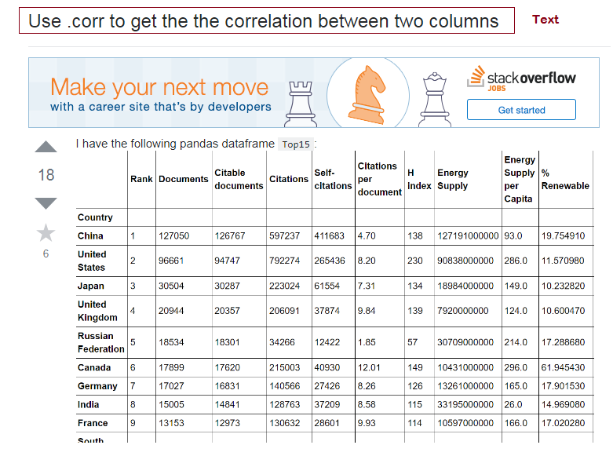
Example 1: Find the correlation between columns
Examples
Stack Overflow Website

Slide 7
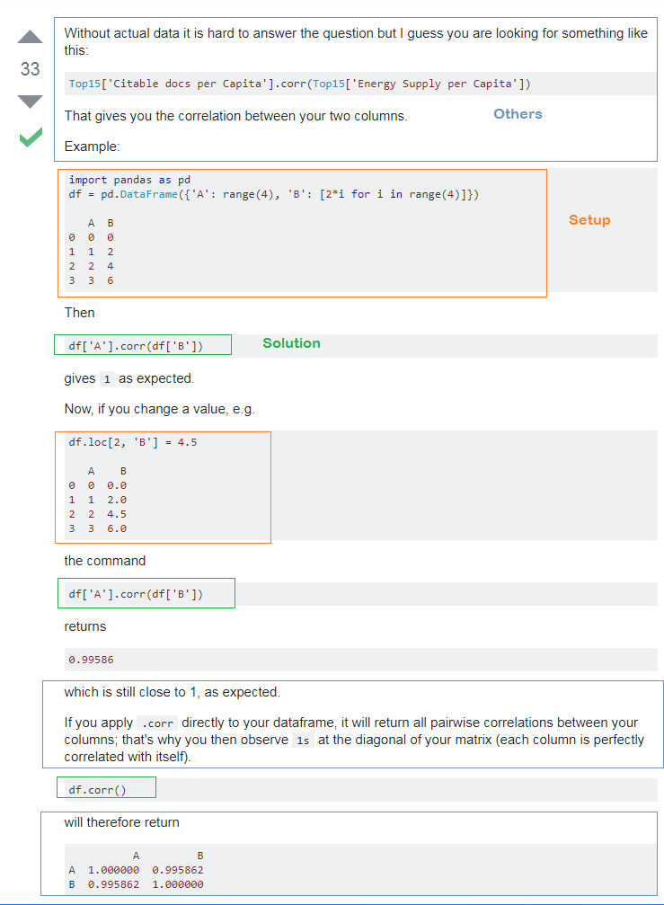
Example 1: Find the correlation between columns
Examples
Stack Overflow Website

Slide 8
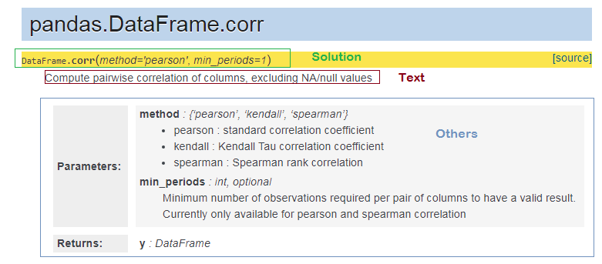
Example 1: Find the correlation between columns
Examples
Pandas API Documentation

Slide 9

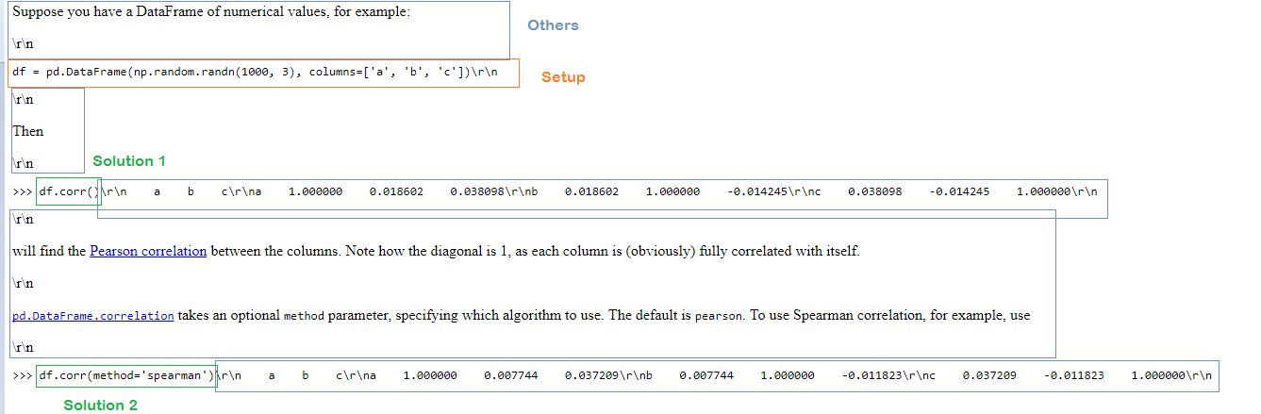
Example 1: Find the correlation between columns
Examples
Stack overflow Documentation Project
Comments
Stack overflow documentation have categorized the problem so that no duplicate questions/queries are there. But the project has been shut down there are less entries. I am thinking of choosing the stack overflow web site as similar methods needs to be formulated to build templates from both Stack overflow documentation as well as stack overflow web site. The only difference is we don’t need to crawl and find the best solution for a query, if we use the documentation project.

Slide 10
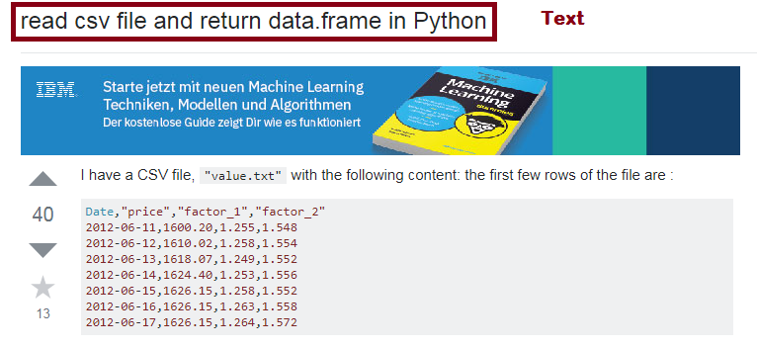
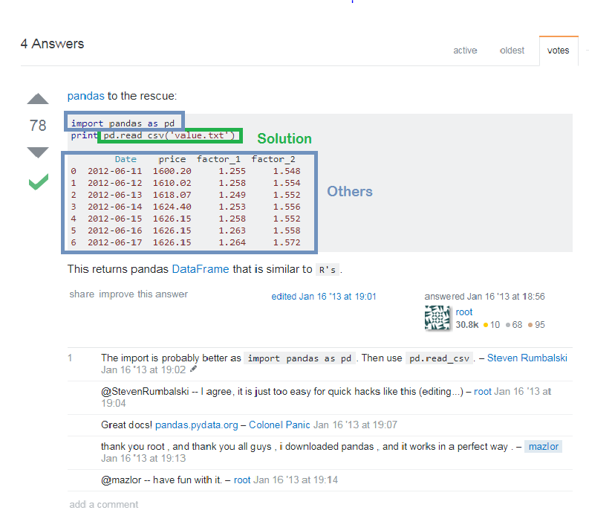
Example 2: Reading CSV file in datafame
Examples
Stack Overflow Website

Slide 11
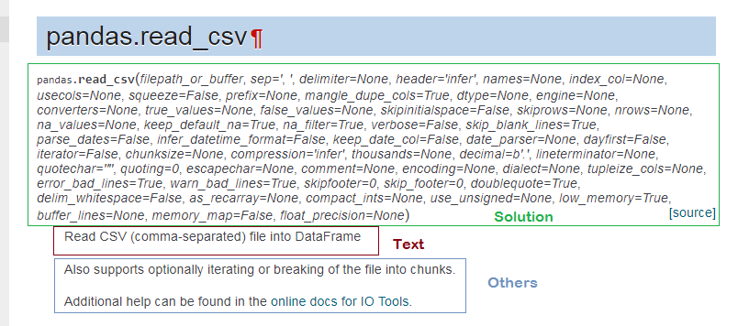
Example 2: Reading CSV file in datafame
Examples
Pandas API Documentation
Comments
As for this example, sometimes stack overflow may not able to give complete solution, there may be additional arguments as shown in API documentation above. Our methods can use both stack overflow and API to generate better recommendation.
There may be multiple ways to solve a problem. Every programmer can solve problem in their own way. API may not cover all these different ways. Hopefully Stack Overflow will help to deal this problem.

Slide 12
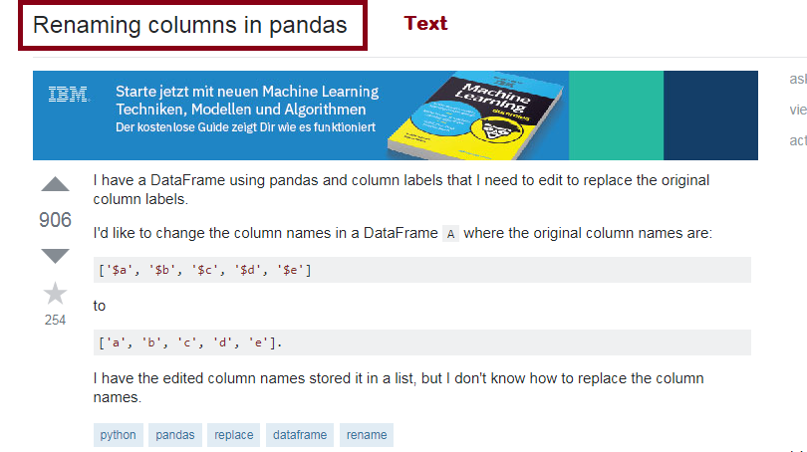
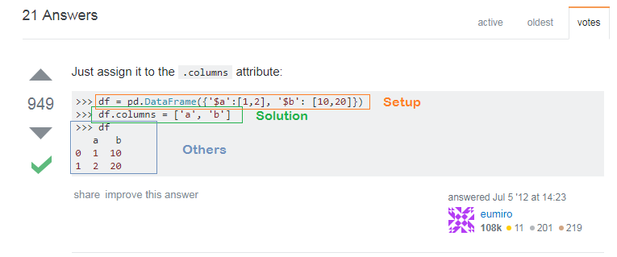
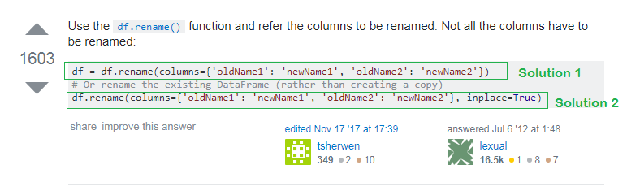
Example 3: Renaming columns in pandas
Examples
Stack Overflow Website

Slide 13
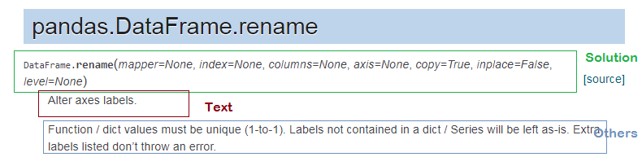
Example 3: Renaming columns in pandas
Examples
Pandas API Documentation
Comments
APIs have generic description of methods which can be applied to any of the instances. For example here user has specified ‘Renaming columns’ which should be mapped to ‘Alter axes labels’ in API documnentation. Mapping query to the API documentation text will be another problem. Stack overflow has an advantage here as the text will be near to the user query.

Slide 14
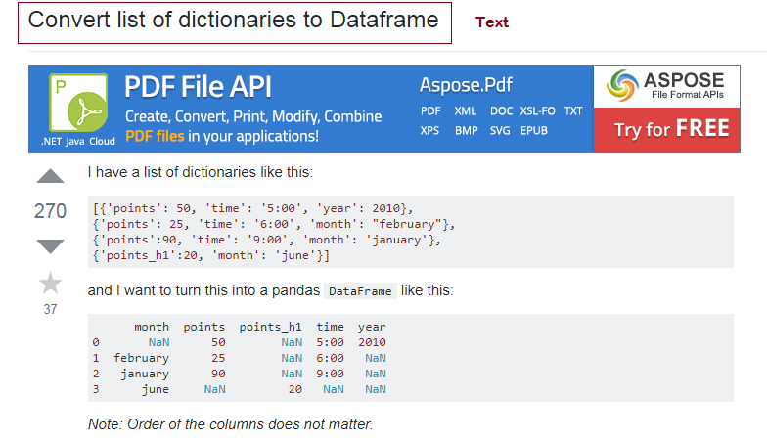
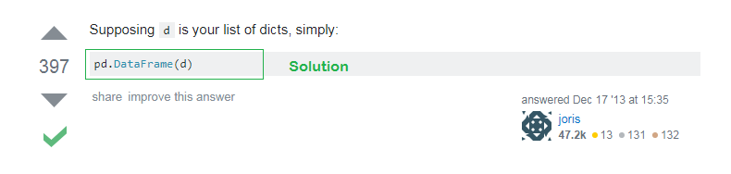
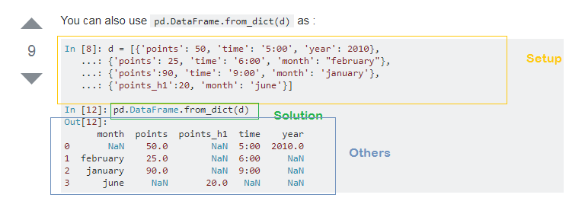
Example 4: Converting List of Dictionaries to Dataframe
Examples
Stack Overflow Website

Slide 15
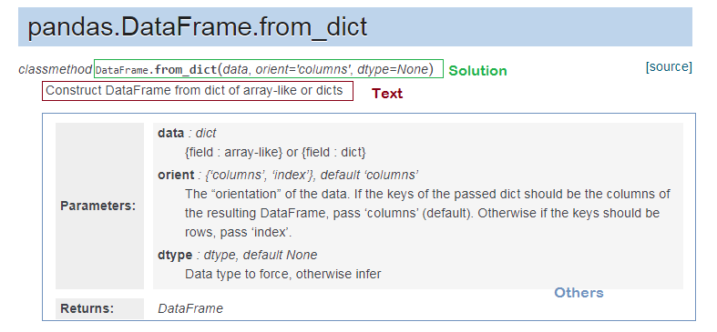
Example 4: Converting List of Dictionaries to Dataframe
Examples
Pandas API Documentation

Slide 16
Thank You!
Neelesh K Shukla
neelesh.shukla@iitg.ernet.in

